Slide 1
Supply Chain 2.0
Expecting More from our Supply Chains… and Ourselves
Thomas J. Goldsby, Ph.D. Harry T. Mangurian, Jr. Foundation Professor in Business
Professor of Logistics
The Ohio State University
Columbus, Ohio (USA)

Slide 2
What is a Supply Chain?
The network of companies that works together to provide a product or service for the end-use market
2

Slide 3
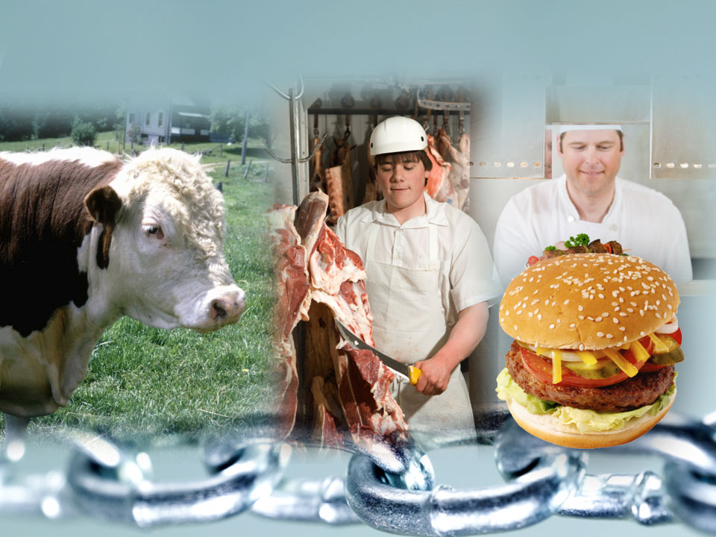
Does a supply chain look like this?

Slide 4
…or, rather, like this?
Tier 3 to
Initial
suppliers
Tier 3 to
Consumers/
End-customers
Tier 2
Suppliers
Tier 1
Suppliers
Tier 1
Customers
Tier 2
Customers
Initial Suppliers
Tier 3 to n suppliers
Consumers/End-customers
1
1
2
2
n
1
n
1
1
2
n
2
1
1
Tier 3 to n customers
3
2
3
n
3
n
n
n
1
2
1
n
n
A supply chain consists of the network of companies that work together to provide a good or service for the end-use market.
Focal Company
Members of the Focal Company’s Supply Chain
© Supply Chain Management Institute. Source: Supply Chain Management: Processes, Partnerships, Performance.

Slide 5
A Process View of SCM
Information Flow
Tier 2
Supplier
Tier 1
Supplier
Manufacturer
Consumer/
End-Customer
Logistics
Customer
Purchasing
Marketing
PRODUCT FLOW
Production
Finance
R&D
CUSTOMER RELATIONSHIP MANAGEMENT
SUPPLIER RELATIONSHIP MANAGEMENT
CUSTOMER SERVICE MANAGEMENT
Supply Chain Management Processes
DEMAND MANAGEMENT
ORDER FULFILLMENT
MANUFACTURING FLOW MANAGEMENT
PRODUCT DEVELOPMENT AND COMMERCIALIZATION
RETURNS MANAGEMENT
© Supply Chain Management Institute. Source: Supply Chain Management: Processes, Partnerships, Performance.

Slide 6
An Economic Theory of Supply Chain Management
CRM
CRM
CRM
Supplier
(D)
Manufacturer
(C)
Wholesaler/
Distributor
(B)
Retailer/
End User
(A)
SRM
SRM
SRM
P&L for
C as customer
Total Cost Report
for D as supplier
P&L for
B as customer
P&L for
C as supplier
P&L for
A as customer
P&L for
B as supplier
Δ Revenue
Δ Cost
Δ Profit
Δ Cost = Δ Profit
Δ Revenue
Δ Cost
Δ Profit
Δ Revenue
Δ Cost
Δ Profit
Δ Revenue
Δ Cost
Δ Profit
Δ Revenue
Δ Cost
Δ Profit
Supply Chain Performance = Increase in Profit for A, B, C, and D
Source: Lambert, Douglas M., Supply Chain Management: Processes, Partnerships, Performance, 4th Edition (2012) SCMI, Sarasota, FL.

Slide 7
Supply Chain 1.0
To date, our supply chains have focused on:
physical flows of inventory
one-way flow of materials
economics
tier-1 relationships up & downstream
single lifecycle

Slide 8
Taking a Broader Look at Supply Chains and their Risks: Sustainable Development
Sustainable Development: “to meet the needs of the present without compromising the ability of future generations to meet their own needs”¹
Economic
In a business context: Focus on the triple bottom line² (economic, environmental, and societal outcomes)
Environ-
mental
Societal
[1) UNWCED, 1987; 2) Elkington, 1998]

Slide 9
Sustainable Value-Add
A new paradigm for business
Short-term → long-term emphasis
Shareholders → stakeholders
Economic value → Sustainable value ³
Essence of sustainability: An enlarged framework to view the making & selling of products/services
(Lazlo, 2008)

Slide 10
Holistic and Total Lifecycle-based Approach
Emphasis on all four product lifecycle stages
OUTBOUND LOGISTICS
Manufacturing
Use
INBOUND LOGISTICS
Pre-manufacturing
Post-use
REVERSE LOGISTICS
Conventional focus has been on the first three life-cycle stages ➔ The cradle-to-grave philosophy
Enlarged framework ➔ cradle-to-cradle philosophy for closed-loop material flow

Slide 11
Sustainable Supply Chain Management (SSCM)
SSCM involves “the planning and management of sourcing, procurement, conversion and logistics activities involved during pre-manufacturing, manufacturing, use and post-use stages in the life cycle in closed-loop through multiple life-cycles with seamless information sharing about all product life-cycle stages between companies by explicitly considering the societal and environmental implications to achieve a shared vision.”
(Badurdeen et al., 2009)

Slide 12
Integrated Approach to SSCM
6R Applications
A broadened perspective for identifying vulnerabilities and value creation opportunities
(Badurdeen et al., 2009)

Slide 13
Sustainability in Supply Chain Operations
Triple bottom-line emphasis on economic, environmental and societal considerations
Total product life-cycle (pre-manufacturing, manufacturing, use and post-use ) focus
Multiple product life-cycle emphasis through the integration of 6Rs) for sustainable supply chains
Increased collaboration and visibility by seamless information sharing for closed-loop supply chain management
(Badurdeen et al., 2009)

Slide 14
Getting Back to Risks: Integrated Approach to Risk Modeling in SSCM
Comprehensive network of risk and interdependency
Methodology for data use from internal/external sources
Integrate likelihood and impact to TBL aspects across life-cycle stages and SC partners
Defined method for computing risk likelihood and evaluating impact on performance criteria
Employed testbed partners Boeing and GE Aviation to develop models

Slide 15
Risk Drivers Across TBL Areas

Slide 16
Propagation of Risks Due to Interdependencies

Slide 17
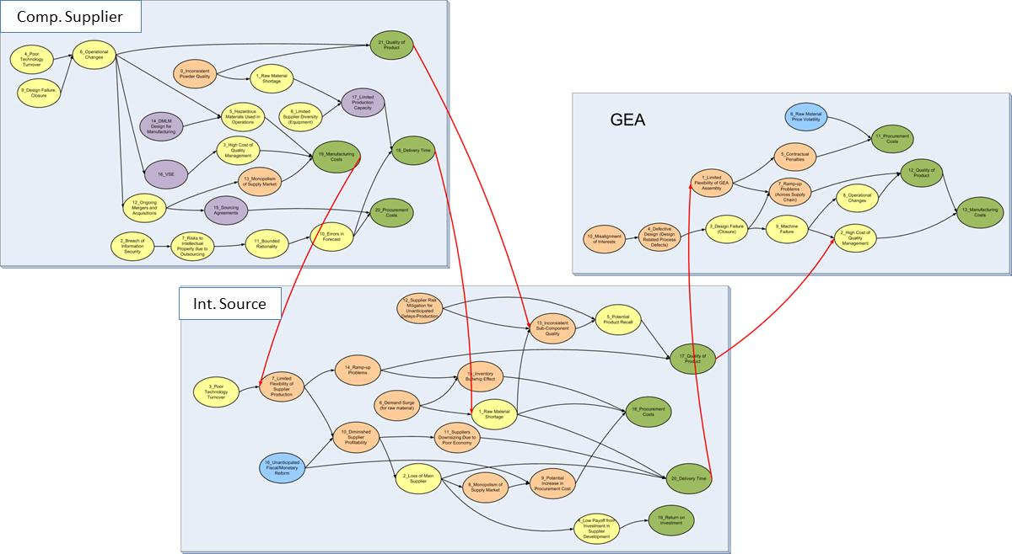
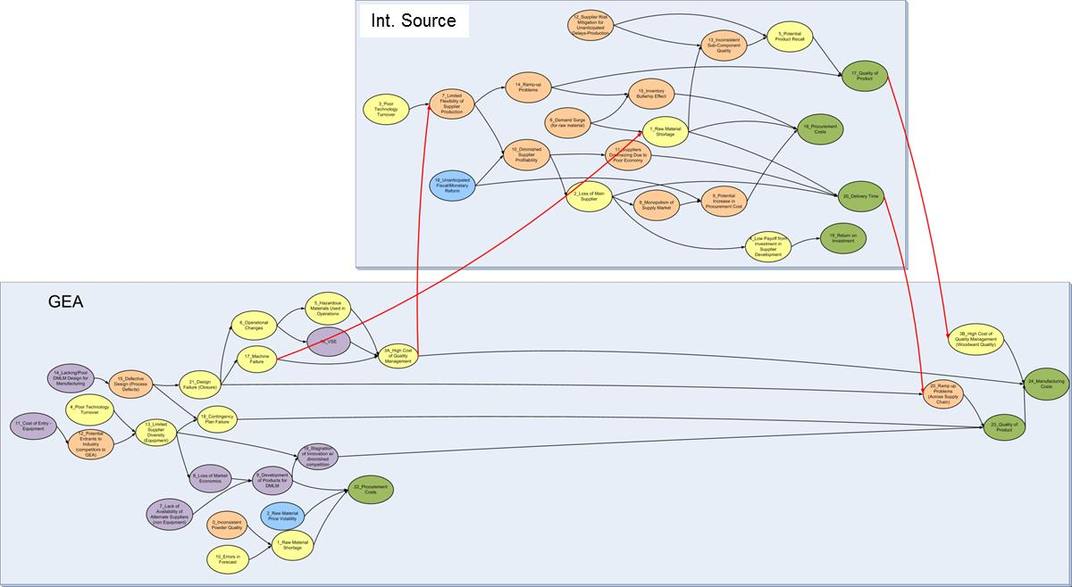
Industry Partner Perspective
Assessing supply chain risk for buying component from supplier vs. making component in-house
“Buy” Scenario Risk Network Map
“Make” Scenario Risk Network Map

Slide 18
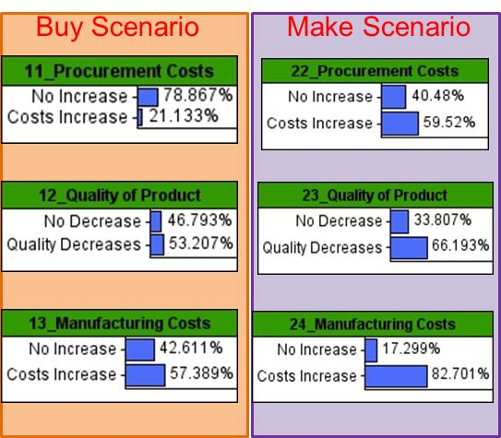
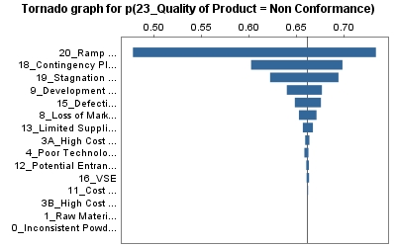
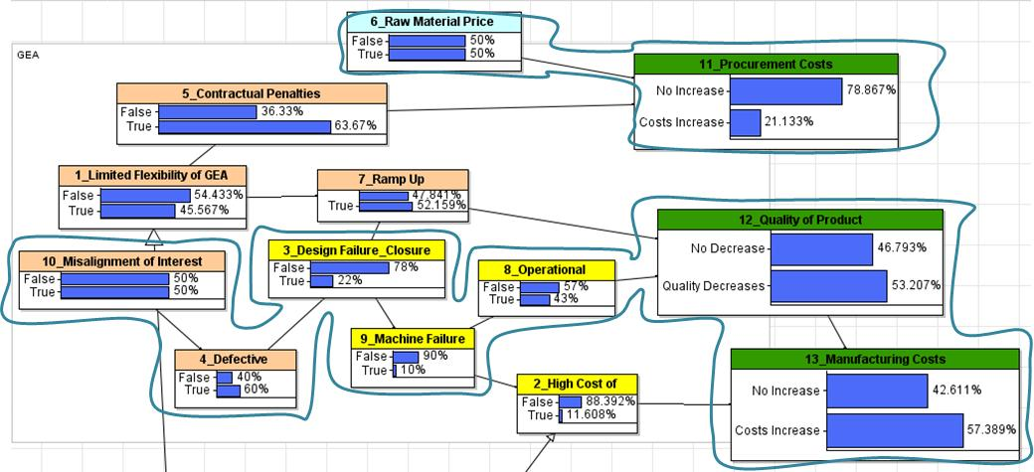
Risk Analysis with Bayesian Networks
Comparison of Performance Measures
Tree Map of Risks
Root-cause Analysis using Tornado Graphs and Scenario Analysis
Tornado Graphs for Sensitivity Analysis

Slide 19
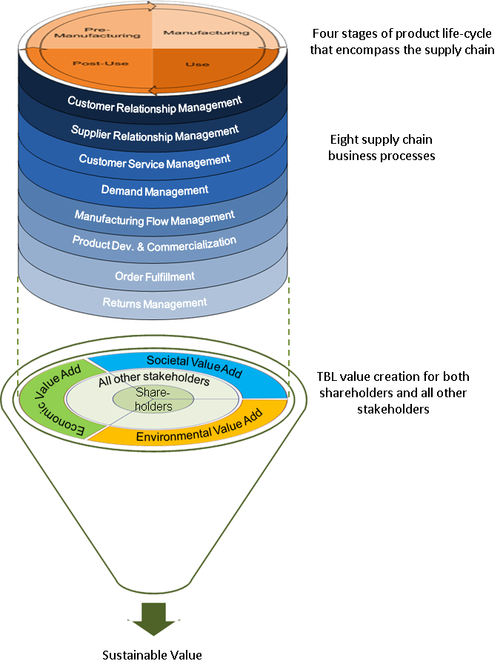
Moving forward…
companies need an integrated approach to create sustainable value for stakeholders across the supply chain, recognizing a broad view of the risks they, individually and collectively, face. We call this Supply Chain 2.0.

Slide 20
Thank you!
Thomas J. Goldsby, Ph.D.
E-mail: Goldsby.2@osu.edu
LinkedIn: Thomas-Goldsby
Twitter: @ThomasGoldsby

