Slide 1
Value Co-Creation: The Underlying Economics and Strategic Considerations
Professor David Gillen
YVR Professor of Transportation Policy & Logistics
Director, Center for Transportation Studies
Sauder School of Business, University of British Columbia

Slide 2
What are we going to talk about and what lens will I use?
To begin, I am the academic, so my perspective is research based (the ”I wonder category”) our industry colleagues will speak to ‘how do we get it done’
Secondly, my training is in economics not operations – which really does not matter – so you will hear a fair amount of supply & demand, rents, economic agents etc.
Thirdly – my research focus has principally been in the transportation field so I will draw some examples from aviation and rail and even trucking/logistics but not exclusively
Lastly, I did make two commitments to Michael; first, I would address the five questions he posed to me and second, I would be on time.

Slide 3
My Wife said I should always show pictures, my prose are boring, so you get 1 picture.
Professor D Gillen WLU circa 1985

Slide 4
Pathway for Today
What are we talking about – ‘value co-creation?
What insights might an economic ‘way of thinking’ provide?
  Simple concepts (4)
  Co-opetition
  Strategic Alliances
  Market structure and co-creation – horizontal versus vertical relationships
Notes:
Value co-creation and customer loyalty ☆
Journal of Business Research
Volume 69, Issue 5, May 2016, Pages 1621–1625

Slide 5
Pathway for Today – cont’d
  Questions we will explore
(1) Have we become better at value co-creation?
(2) Are we poised to become better in the future?
(3) What current/imminent trends might support/hinder successful value co-creation?
(4) Which organizations are exemplars of value co-creation (examples need not be limited to the typical private business supply chains; e.g., could be from the public sector)
(5) What are some key managerially relevant connections between value co- creation and other topical contemporary issues in SCM (e.g., leadership, risk, and resilience) or stated differently What has been (must be) done to equip current and future supply chain leaders with the capacity to be successful in value co-creation endeavors?
Final Issue: Role of ‘Big Data’ in Co-creation
Notes:
Value co-creation and customer loyalty ☆
Journal of Business Research
Volume 69, Issue 5, May 2016, Pages 1621–1625

Slide 6
Value Co-Creation
  “process by which products, services and experiences are developed jointly by companies and their stakeholders opening up more opportunities for value”.
  Rather than seeing firms as creating value that consumers use up, companies and consumers need to engage in co-creating value in the entire system
  Value creation is horizontal collaboration interaction internal to the firm for mutual exchange and benefit; value co-creation involves vertical or external co-operation (but not integration).
  (adapted somewhat from Venkat Ramaswmay)
Notes:
Value co-creation and customer loyalty ☆
Journal of Business Research
Volume 69, Issue 5, May 2016, Pages 1621–1625
I define co-creation as the “purposeful action of partnering with strategic customers, partners or employees to ideate, problem solve, improve performance, or create a new product, service or business.”

Slide 7
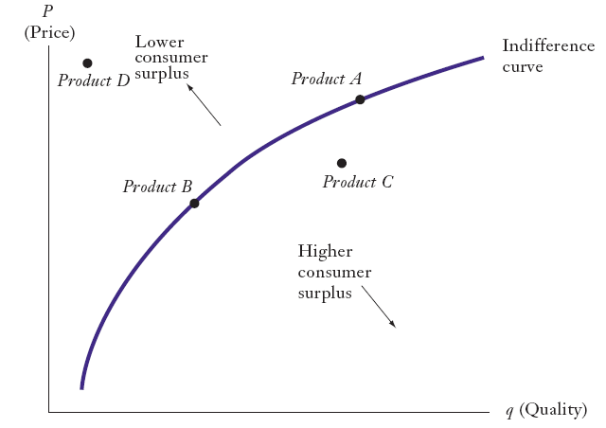
The Value Map*
D. Besanko, D. Dranove, M. Shanley and S. Schaefer (2004), The Economics of Strategy, 3rd Edition John Wiley & Sons

Slide 8
Value Created and Economic Profits
Value created = Consumer surplus +
Producer surplus
= (B - P) + (P - C)
= B - C
A positive (B - C) does not guarantee economic profit. Competition among producers can allow consumers to capture all of the value created.

Slide 9
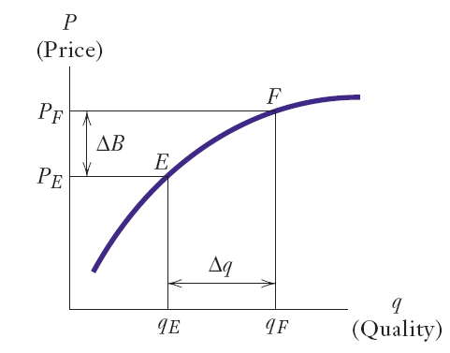
Tradeoff between Price & Quality*
Star vs Emirates?
More Value
D. Besanko, D. Dranove, M. Shanley and S. Schaefer (2004), The Economics of Strategy, 3rd Edition John Wiley & Sons

Slide 10
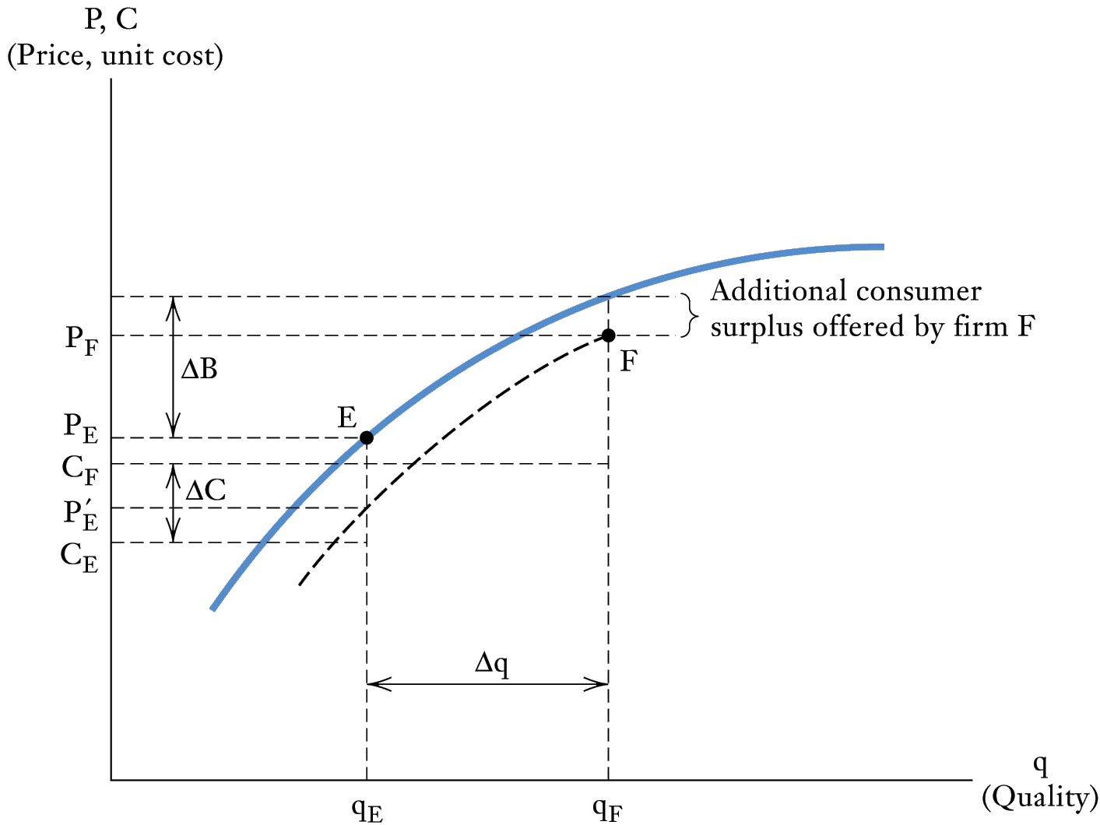
The Economic Logic of Benefit Advantage
D. Besanko, D. Dranove, M. Shanley and S. Schaefer (2004), The Economics of Strategy, 3rd Edition John Wiley & Sons

Slide 11
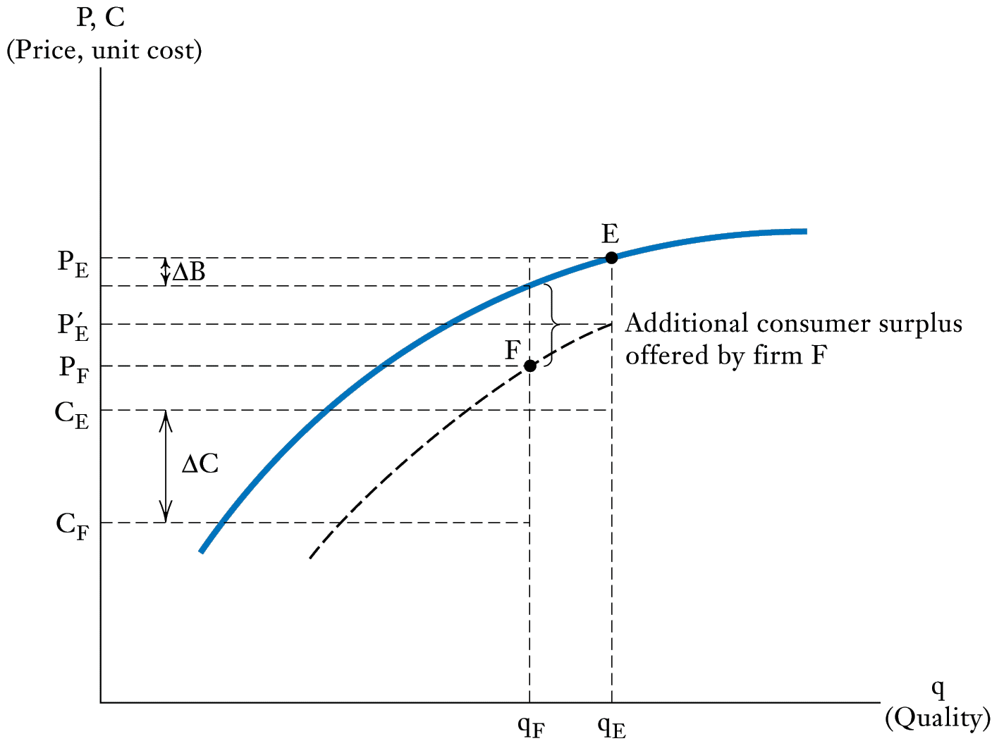
The Economic Logic of Cost Advantage
D. Besanko, D. Dranove, M. Shanley and S. Schaefer (2004), The Economics of Strategy, 3rd Edition John Wiley & Sons

Slide 12
Notes:
Value co-creation and customer loyalty ☆
Journal of Business Research
Volume 69, Issue 5, May 2016, Pages 1621–1625

Slide 13
Strategic Alliances
  Offer insights for understanding value co-creation
  Can take many forms from simple marketing agreements to significant co-investments
  In the middle of the supply chain internalizing externalities (spillovers) – e.g. pricing to maximize market size
  At the end of the supply chain – increasing value to customer of joint provision – e.g. greater frequency and choice of destinations
  Opportunities to develop and exploit market power
Notes:
Value co-creation and customer loyalty ☆
Journal of Business Research
Volume 69, Issue 5, May 2016, Pages 1621–1625

Slide 14
Market Structure & Co-Creation
  How does the relative market power of upstream and downstream firms in the supply chain affect co-creation incentives?
  What are the differences in terms of market power between value co-creation horizontally within markets versus vertically in the supply chain?
  If co-creation creates rents, how are they distributed?
    There is only one source of rent, must compete for it
  What role do clustering and agglomeration economies play?
Notes:
Value co-creation and customer loyalty ☆
Journal of Business Research
Volume 69, Issue 5, May 2016, Pages 1621–1625

Slide 15
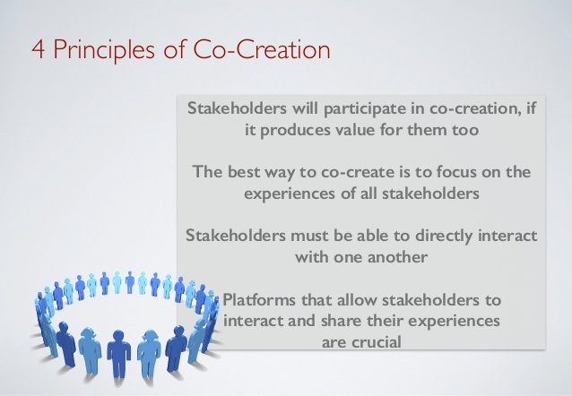
Principles of
Co-creation
  Point 1: incentives are important
  Point 2: creating opportunities for sub-coalitions can be destructive
  Point 3: network communication is point-to-point?
  Point 4: what about 2-sided markets? E.g. e-bay
Notes:
Value co-creation and customer loyalty ☆
Journal of Business Research
Volume 69, Issue 5, May 2016, Pages 1621–1625

Slide 16
Value Co-Creation: In the Middle versus the end of the Supply Chain?
Two (or more) economic agents jointly co-operate to created an outcome valued by both and not possible without co-operation
  Doing things better versus doing new things – do they both count?
  Is a product/service initiative as much value as an operational initiative
Co-creation at the end of the supply chain focuses on demand and value added is measured by additional consumer surplus
Co-creation in the middle of the supply chain focuses on supply and is measured by lower costs and/or improved efficiency
Notes:
Value co-creation and customer loyalty ☆
Journal of Business Research
Volume 69, Issue 5, May 2016, Pages 1621–1625

Slide 17
Co-creation in the Middle versus the end of the Supply Chain
  In principle we can experience B2C, C2B, B2B and C2C
  Much of the established literature has concentrated on the end of the supply chain – B2C
  How far along the production-consumption chain should we look for co-creation?
    Subaru produces automobiles by combining knowledge, skills and resources and this has value in exchange between Subaru and people who want to purchase a Subaru. Value is in exchange
    However, a Subaru has value to customers only because people know how to drive and have places to go. The value is in use. NOTE: if this were true the customer would always be a co-creator of value but it also means that value in exchange is endogenous since firm looks to what people want to imbed value (e.g. horsepower).
    Value co-creation is establishing electric charging stations from Vancouver to LA
Notes:
Value co-creation and customer loyalty ☆
Journal of Business Research
Volume 69, Issue 5, May 2016, Pages 1621–1625

Slide 18
Co-creation in the Middle versus the end of the Supply Chain
  Value co-creation in the middle of the supply chain
    Why is it so difficult? Why is it not more common?
  Co-creation turns a one-way road into a two-way road – so like a two lane road we have more traffic, more opportunity for conflict but also more capacity or more efficient/effective use of existing capacity.
    Does value creation create wealth for the firm while value co-creation creates wealth for the system or supply chain?
    Does the firm create value, does it co-create value and provide service or is it an ‘experience’ that is created?
Notes:
Value co-creation and customer loyalty ☆
Journal of Business Research
Volume 69, Issue 5, May 2016, Pages 1621–1625

Slide 19
Co-creation in the Middle versus the end of the Supply Chain – An Example with Railways
  CN and CP have developed co-running or co-production regimes
    Railways in North America spend roughly 18% of revenues on capital projects
  Do we need more capital or do we need to manage our capital better? Co-production with other railways.
    Directional running (e.g. Fraser Canyon, Georgian Bay)
    Haulage rights
    Rationalization of duplication
    Reciprocal access to bottleneck locations (e.g. North side Burrard Inlet)
    IMPACT
      Increased line capacity
      Eliminate redundant infrastructure/facilities
      Improve resilience - Provision for alternatives at times of accidents or weather incident
Notes:
Value co-creation and customer loyalty ☆
Journal of Business Research
Volume 69, Issue 5, May 2016, Pages 1621–1625
In Canada, one of the most prominent co-production agreements was negotiated between CP and CN in 2000 that includes the highly successful directional running zone through the Fraser Canyon in British Columbia.
More recently, CP and CN have negotiated a directional running agreement over about 100 miles of parallel CP and CN track in Ontario between Waterfall, near Sudbury, and Parry Sound. The two railways operate eastbound trains over the CN line and westbound trains over CP’s line, improving network fluidity in this corridor.

Slide 20
(1) Have we become better at value co-creation?
  What does value co-creation require?
    Value co-creation moves from teaching the customer to learning from each other.
    Sharing information – vulnerable to hold up problem
      To most managers, the thought of openly and transparently engaging customers, sharing detailed data is scary
    Customization – deepening relationships, innovation
      Commitment, reducing options, long term view
    Targeting your co-creators
      Doing homework as to what appeals to participants, choose your markets, customers and partners wisely
      Motivation – compensation, recognition, curiosity, social butterflies
    Sustainability- of competitive advantage
      Customer focus - price leader, product innovator or superior service
      Supplier focus - cost advantage -
Notes:
Value co-creation and customer loyalty ☆
Journal of Business Research
Volume 69, Issue 5, May 2016, Pages 1621–1625

Slide 21
(2) Are we poised to become better in the future?
Source: Performance, Vol. 6, issue 3, 2014
Notes:
Value co-creation and customer loyalty ☆
Journal of Business Research
Volume 69, Issue 5, May 2016, Pages 1621–1625

Slide 22
(2) Are we poised to become better in the future?
  Is this the right tool (approach?) – to create value
    Is co-creation superior to value creation
    Is co-creation better used in certain industries?
  What are the goals of co-creation?
    Tripling your stock price?
    Responsibility – financial, social, environmental
  What are the right metrics?
    Invest in growth or margin improvement
    E.g. airport privatization
  Where do we want to be in the supply chain?
    At the end or in the middle, why? (adjacency & leapfrogging)
Notes:
Value co-creation and customer loyalty ☆
Journal of Business Research
Volume 69, Issue 5, May 2016, Pages 1621–1625

Slide 23
(3) What current/imminent trends might support/hinder successful value co-creation?
  Co-creation requires commitment, transparency & responsibility
  Co-creation is not just about problem solving or tweaking products – new markets should be explored
  Honest and transparent with co-creation partners – customers/suppliers, both?
  The Right Culture – making a mistake is not the worst thing someone can do – outside the comfort zone
  External co-creation requires internal organizational consistency
  Sharing the rents – e.g. Spirit versus Delta (Air Canada)
Notes:
Value co-creation and customer loyalty ☆
Journal of Business Research
Volume 69, Issue 5, May 2016, Pages 1621–1625

Slide 24
(3) What current/imminent trends might support/hinder successful value co-creation?
  Company centric view*:
  Consumer is outside the value chain
  Firm controls where, when and how value is added in the value chain
  Value is created by activities controlled by the firm prior to purchase
  A single point of exchange extracts value from the customer
  Consumer centric view
  Customer is integral to system of value creation
  Customer can influence where, when, how value is generated
  Customer can go beyond industrial boundaries to extract value
  Customer can compete with industry for value extraction
  There are multiple points of exchange where customers and firms can co-create
    How transactions are managed
    How choices are established
    How customer experience is staged
    How price & performance relate
Notes:
Value co-creation and customer loyalty ☆
Journal of Business Research
Volume 69, Issue 5, May 2016, Pages 1621–1625
Companies are getting more used to competing on the basis of their adaptability and how fast they innovate and apply knowledge, and they are rising to the challenge of keeping down the costs of experimentation as they test new ideas. But business competition is a lot more unpredictable when innovation and flexibility, rather than efficiency, are the main drivers of value.

Slide 25
(4) Which organizations are exemplars of value co-creation?
  Are there certain organizations that either have a greater propensity to co-create or a higher success rate at co-creation?
  Answer: ask what are the building blocks for co-creation
    Business operates in a network environment – there is upstream & downstream learning, these are opportunities
    (1) Dialogue – meaning engagement, empathetic understanding (e.g. not the music business)
    (2) Access – do not need ownership to have experience (e.g. car sharing)
    (3) Risk reduction – co-creation means parties must share responsibility for risk reduction (risk can be efficiently allocated)
    (4) Transparency: business process information is shared (e.g. FedEx, UPS, Canada Post)
    Key: co-creation is about partnerships
Notes:
Five principles of co-creation:
Take a broad view
Work from the bottom up
Trust the process
Put people first
Leverage technology
Example: Co-creating climate strategy
Co-creation is about a fundamentally different way of conducting the business of government. For instance, when the Danish government decided to formulate a new strategy to combat climate change while driving new business growth, its delivery required close coordination among several different government departments. Under normal circumstances, this would have provoked turf wars: for example, the environment department would be unlikely to embrace the same objectives and solutions as, for instance, the business ministry. However, in this co-creation exercise, government officials worked in a different way. They cut across the organizational ‘silos’ and the new policy was crafted in the course of a series of design workshops that involved businesses and citizens as well as academics, experts and artists. The strategy is exemplified today as, amongst others, the Copenhagen Climate Consortium, a public-private partnership, one of its implementations.

Slide 26
(5) What are some key managerially relevant connections between value co - creation and other topical contemporary issues in SCM (e.g., leadership, risk, and resilience)?
  Go back to the question posed about organizations and organizational structure
  What must companies do in value co-creation?
    Move away from company centric perspective – customers are partners (e.g. Frito-Lay 2007)
    Move away from traditional view of tasks needed to create value, therefore change internal structure (market research, product development, logistics, branding, pricing, and accounting )
    Business competition with value co-creation is more unpredictable when innovation rather than flexibility & efficiency are key drivers of value (adaptability, speed to innovate & apply knowledge, costs of experimentation)
    Information architecture that shares data (information?) and incorporates principles of balanced system of value creation (middle versus send of supply/value chain)

Slide 27
What is the Role of Big Data in Value Co-creation?
  90% of the data we have today in less than 2 years old!
  Today’s competition is ‘data competition’ which requires technology to compete
  Challenges - Data reveals patterns in customers, businesses & markets (i.e. reveals information)
  Opportunities - Data allows you to measure outcomes (from competitive strategies)
  Big data generates ‘cooperative assets’ based on an integration of customer data + firm data – it is the one versus 2 way street.
    Data Resources and data platforms
Notes:
Value co-creation and customer loyalty ☆
Journal of Business Research
Volume 69, Issue 5, May 2016, Pages 1621–1625

Slide 28
What is the Role of Big Data in Value
Co-creation? One Perspective*
  Distinguish service dominant versus goods dominant logic – service is the fundamental component of economic exchange.
  Service requires two types of resources
    Tangible resources (labour, materials, infrastructure)
    Intangible resources (knowledge, skills, experience)
  Value identification
    Asset value – economic value, emphasizes customer purchasing behaviour
    Engagement value – comprehensive interpretation of customer behaviour (lifetime value, referral value, influence value, feedback/knowledge value
Notes:
Value co-creation and customer loyalty ☆
Journal of Business Research
Volume 69, Issue 5, May 2016, Pages 1621–1625

Slide 29
The relevance of big data and value co-creation
  Information technology and service-dominant logic
    Internet empowers customers and compels firms to be more customer centric
    Internet reduces information asymmetry – changes relative bargaining power
    Internet creates communities where non previously existed and strengthens interactions
    Internet intensifies market competition
    Therefore, it is necessary to excavate customer data and analyze potential demand in advance of competitors
    IT is an enabler for service dominant logic (collects data, storage, communication, analysis, prescriptive action)
Notes:
Value co-creation and customer loyalty ☆
Journal of Business Research
Volume 69, Issue 5, May 2016, Pages 1621–1625

Slide 30
The relevance of big data and value co-creation
  Big Data and Value Co-creation
    Big data is customer centric – volume, velocity and variety (e.g. online shopping generates, browsing, abandonment, purchases, combinations, timing, opinions)
    Big data from customers is ‘a form of capital’ and leads to – new products, realigning business strategies
    Firms cannot utilize the new capital effectively because they misclassify it
      Old – structured data (e.g. rating & ranking) and unstructured data (e.g. opinions, complaints - amorphous and needs to be preprocessed to be useful)
      New – value based classification based on customer behaviour and actions
    Key: data platforms to co-create with customers
      platforms enhance the efficiency and effectiveness of service exchange by making resources liquid, increasing resource density, and facilitating easy access to appropriate resource bundles
Notes:
Platforms refer to refer to the digital service platforms enabled by big data technologies. These platforms enhance the efficiency and effectiveness of service exchange by making resources liquid, increasing resource density, and facilitating easy access to appropriate resource bundles [34]. Big data platforms range from common online transactional platforms (transactional exchanges), virtual social networking platforms (consumer community communication), open-design platforms (customer self-help design), and mobile interaction platforms (firm–customer communication).

Slide 31
Data Information Resources
  Four different big data information resources generated by customer roles:
  Transactional - enables the collection of exchange data, the transmission of data for analysis, and rapid responses back to customers
  Communication - customer feedback (transactional), group behaviour (social networks) hide mountains of value
  Participative – customer knowledge, resources, skill lead to product development (e.g. DeWalt)
  Transboundary - data generated by customers who share different service systems - comparisons
Notes:
Value co-creation and customer loyalty ☆
Journal of Business Research
Volume 69, Issue 5, May 2016, Pages 1621–1625

Slide 32
Summary
  Some would claim there is a shift from efficiency centric (cost & productivity) to experience centric (demand) or from the middle to the ends of the supply/value chain
  places pressure on industrial infrastructure, business systems and organizations.
  Blurs the vertical boundaries of the corporation with co-investments (customer equity)
  Value of co-creation is the sum of customer B + enterprise B + shared B
  Value of data capital is contingent on both customers and enterprises cooperating
Notes:
Value co-creation and customer loyalty ☆
Journal of Business Research
Volume 69, Issue 5, May 2016, Pages 1621–1625

Slide 33
Summary
  Is co-creation an attempt to harness disruptive technological change
    big data, machine learning, artificial intelligence, quantum computing and blockchain
  Can co-creation with public institutions reduce the ‘government gap’? (e.g. Uber)
Notes:
Value co-creation and customer loyalty ☆
Journal of Business Research
Volume 69, Issue 5, May 2016, Pages 1621–1625

Slide 34
Discussion?
david.gillen@sauder.ubc.ca

