Slide 1
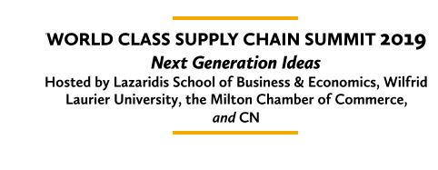
On-Demand Distribution Systems
May 2019
Jennifer Pazour, Ph.D.
Associate Professor of Industrial and Systems Engineering
pazouj@rpi.edu

Slide 2
Changing Customer Expectations
On-Demand Distribution Platforms
Questions and Answers
On-Demand Warehousing Models & Preliminary Results
Rethink Distribution Design
Overview
Acknowledgements:
Partially funded by the US National Science Foundation CAREER award 1751801;
Johnson & Johnson WiSTEM2D program

Slide 3
Distribution & Logistics are at an Inflection Point.
1
Notes:
The first point I would like to make today is that distribution is at an inflection point. What worked well in the past, will not work well in the future. And likely you personally have contributed to this change.

Slide 4

Notes:
How? Well show of hands, how many of you have purchased something online in the last week? What types of things did you buy? Maybe some of you purchased a new book, others shampoo for your child, and maybe even others got their prescription drugs delivered to their homes rather than traveling to a pharmacy.
How long were you willing to wait to receive your order? I bet you wanted your items quickly. Were you willing to wait a week? Or less? Maybe only a couple days. Anyone demand one-hour delivery?
When you placed your order, I bet you did not order a pallet worth of things. Instead, you likely requested a single unit.
Where did you get your products delivered? to your house? So that means the number of demand points to fulfill all the requests is equal to the number of chairs in this room.
Finally, how much were you willing to pay for delivery? Recent surveys have shown, not much.
Therefore, you have contributed to a fundamental change in how supply chains need to respond to fulfill customer requests.

Slide 5
Today’s Customers Expect
Motivation
a wide variety of requests
to be fulfilled quickly
with little warning
in small units
to many dispersed locations
at low costs.
Notes:
Today’s customers – you and I – are demanding changes. We expect a wide variety of requests, to be fulfilled quickly, with little warning, in small units, to many dispersed locations at low costs.

Slide 6

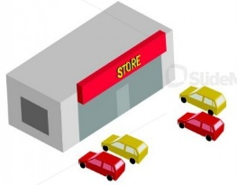
Motivation
Today’s Distribution Systems are Optimized for Yesterday’s Customers
Today
Yesterday
Notes:
This is fundamentally different than yesterday’s demand, which aggregated at fixed (store) locations.
Existing distribution solutions, which are often static, lack unit-level visibility, and have long decision lead times, are too rigid for today’s customers. This has left a gap between what today’s customers demand and what companies can deliver. Put another way, today’s supply Chains are optimized for yesterday’s customers.

Slide 7
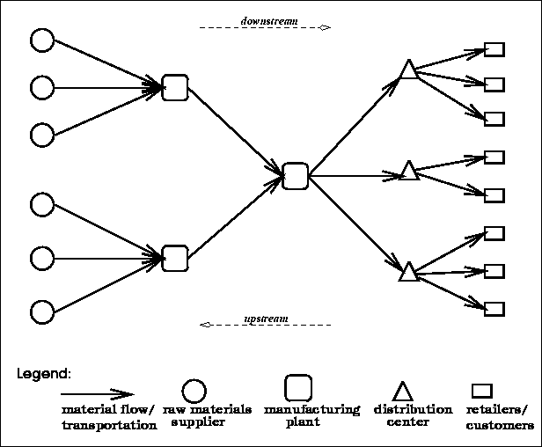
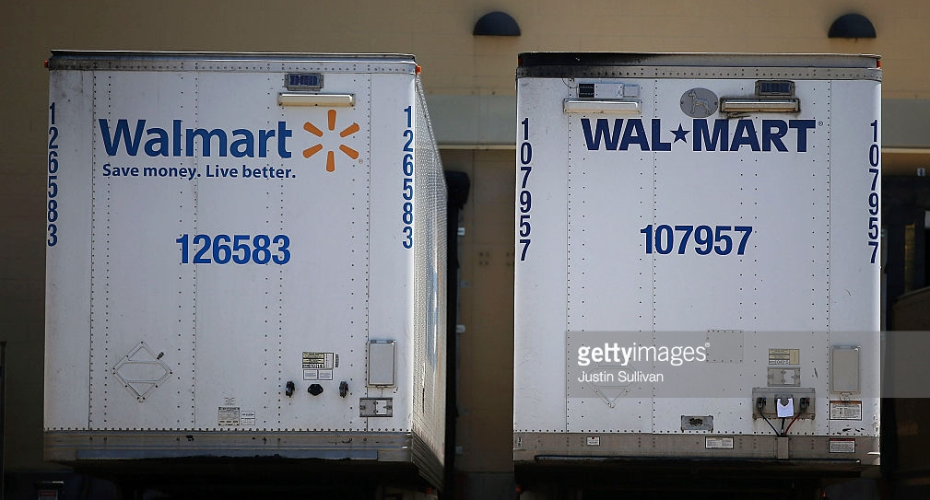
Motivation
Today’s Distribution Systems are Optimized for Yesterday’s Customers
What Worked Well in the Past?
Build Resource Efficiencies through Economies of Scale for Known, Fixed, & Aggregated Demand Points
Notes:
So maybe, just retail as we know it is dead; but that doesn’t mean distribution is.
Unfortunately not.
Then tie to distribution; JDA citation;
IBM’s IBV study of 15 000 Generation Z shoppers, which represent $44-billion in estimated buying power
A mere 17% can provide more than in stock/out of stock information.
https://it-online.co.za/2017/01/16/retailers-battle-to-meet-consumer-needs/

Slide 8
A 2017 JDA survey found only 10% of global brick-and-mortar retailers are profitably fulfilling
e-commerce orders.
http://now.jda.com/CEO2017.html
IBM’s 2017 Customer Experience study of more than 500 brands in 24 countries shows that despite changing customer demands, businesses are struggling to deliver on the expectations of consumers.
https://www-935.ibm.com/services/us/gbs/thoughtleadership/uniquelygenz/
B2C Trends are Bleeding into B2B Trends
60% of industrial buyers now expect 1-2 day delivery
Source: Ware2go
Notes:
My hypothesis is supported by a number of recent surveys. Two worthy of pointing out is a JDA survey that found only 10% of global brick and mortar retailers are profitably fulfilling e-commerce orders. Another study found that businesses globally are struggling to delivery on the expectations of consumers.
Why? Well I believe if we look at what worked well in the past, distribution and logistics success as built on efficiencies through economies of scale, but this relied on the advantage of knowing where your demand occurred; which was at a store location; these were known, fixed, and allowed for aggregation of demand. This structure no longer exists.
So maybe, just retail as we know it is dead; but that doesn’t mean distribution is.
Unfortunately not.
Then tie to distribution; JDA citation;
IBM’s IBV study of 15 000 Generation Z shoppers, which represent $44-billion in estimated buying power
A mere 17% can provide more than in stock/out of stock information.
https://it-online.co.za/2017/01/16/retailers-battle-to-meet-consumer-needs/

Slide 9
We need to Rethink Distribution and Logistics Design
2
Notes:
This brings me to my second key takeaway, which is that we need to rethink distribution and logistics design.
To close the gap between current operations and customer expectations, we need to think differently. This is the focus of my research.
Extra:
my research does this by harnessing data and combines this data with new models to drive agile and dynamic decision making.

Slide 10
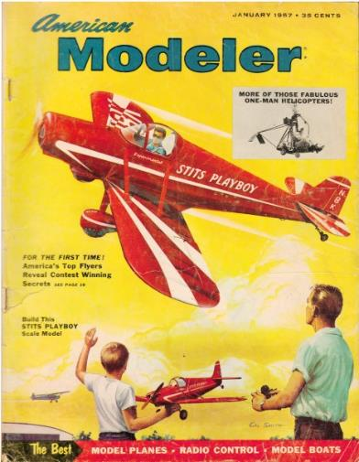
Fundamentally, I am a Modeler
Develop mathematical and computational representations of real-world systems and processes.
Study the structure of the model and develop solution approaches.
Use models to study and understand the dynamics and properties of the system and processes.
Recommend strategies and policies that optimize performance measures.

Slide 11
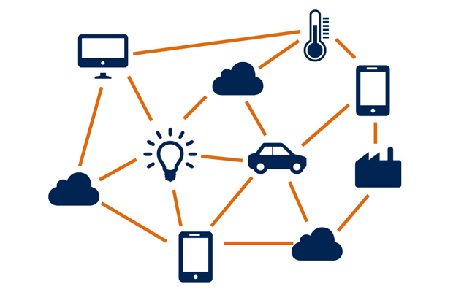

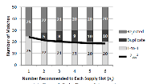
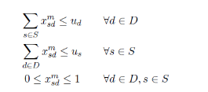
Research Methodology: Applied Operations Research
Develop and use mathematical models to guide
decision making for supply chain and logistics challenges.
New Systems & Processes
Mathematical
Models & Algorithms
Insights and Recommendations
Decision-Support Systems & Data-Driven Decisions
Maximize
New Insights Policy &
Design Recommendations
Determine what to Model
Trade-Off Analysis
Mathematical Modeling
Structural Results,
Solution Approach
Computational Experiments
Visualization Techniques
Provide Decision Trade-offs
Interactive Tool Development

Slide 12




Awesome Research Team
Undergraduate Researchers
Ana Duque
Tina Nazario
Brooke Ramlakhan
Wenlin Gong
Anand Gandhi
Ning Zhang
Fiona Flynn
Parker Shawver
Hannah Horner
Math PhD Student
Rosemonde Ausseil
ISE PhD Student
ISE Ph.D. Student
Kaan Unnu
Safron Smith,
MS Student
Researcher
Recent Focus: Rethinking Supply Chain Design to Meet the Demands of Modern Distribution
Notes:
Transition – So all of these awesome people are working on quite diverse problems, but they are centered around one theme…

Slide 13
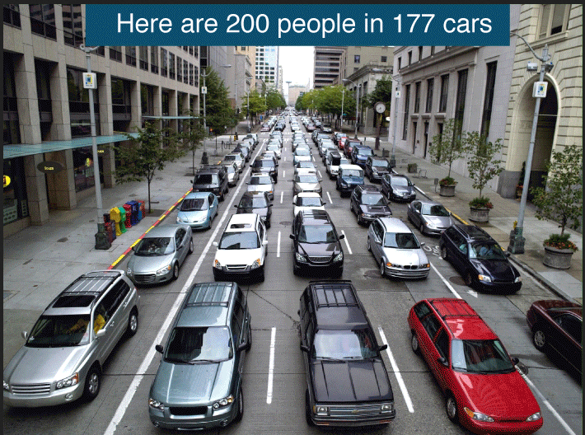
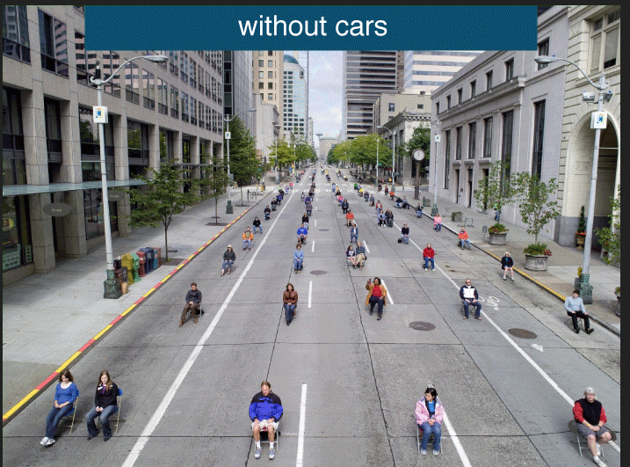
Rethink Supply Resource Capacity
Source: Pictures of Seattle’s 2nd Avenue from the International Sustainability Institute’s Commuter Toolkit Poster
Notes:
One way to think differently is to rethink what we mean by supply resources and capacity.
Agile supply chains can be achieved by unlocking under-utilized capacity.
To illustrate, raise of hands, how many think there is extra capacity available? Could you transport more people or products on this road?
Now if I asked you the same question, is there extra capacity. The answer is clearly yes.
These pictures illustrate that we need to think differently about capacity.
First, we need to think in different granular units, not at the vehicle level, but smaller.
Second, resource allocation decisions need to be operationalized.
One way to rethink supply chain design is to rethink what we mean by supply resources and capacity. An example of a project focused on how to design agile supply chains, looks at how to unlock underutilized capacity through new technologies, processes, and data. The best way to explain this is through a picture. Based on this picture, do you think there is any extra capacity available? Could you transport any more people or things on this road? What do you think? When I ask my students this question, many of them comment that we could add a biker or a pedestrian.
Now if I ask you the same question, is there any extra capacity available to transport more people or things on this road? The answer is clearly yes. However, we need to think differently about what we mean by capacity. First, we need to think in different granular units – not at the vehicle level, but smaller. Also, we need to redefine capacity to be more collective, and peer-to-peer, and less rigid based on ownership or long-term contracts. We need to operationalize capacity. This requires innovative solutions and advances in data science – because who can participate is a fluid collection of entities. But also has great potential to address today’s customers expectations – by tapping into underutilized capacity that exists all around us.
Extra:
owned. not only based on long-term partnerships, instead underutilized capacity exists all around us- but it is “peer-to-peer capacity”.
what do we need to do – we need to look at different units of capacity than typically thought of. We are not asking if another vehicle can fit, but instead if another human can fit. So there is a lot of underutilized capacity – however, we need innovative solutions to be able to effectively utilize this capacity. This is one very promising solution in supply chains…

Slide 14
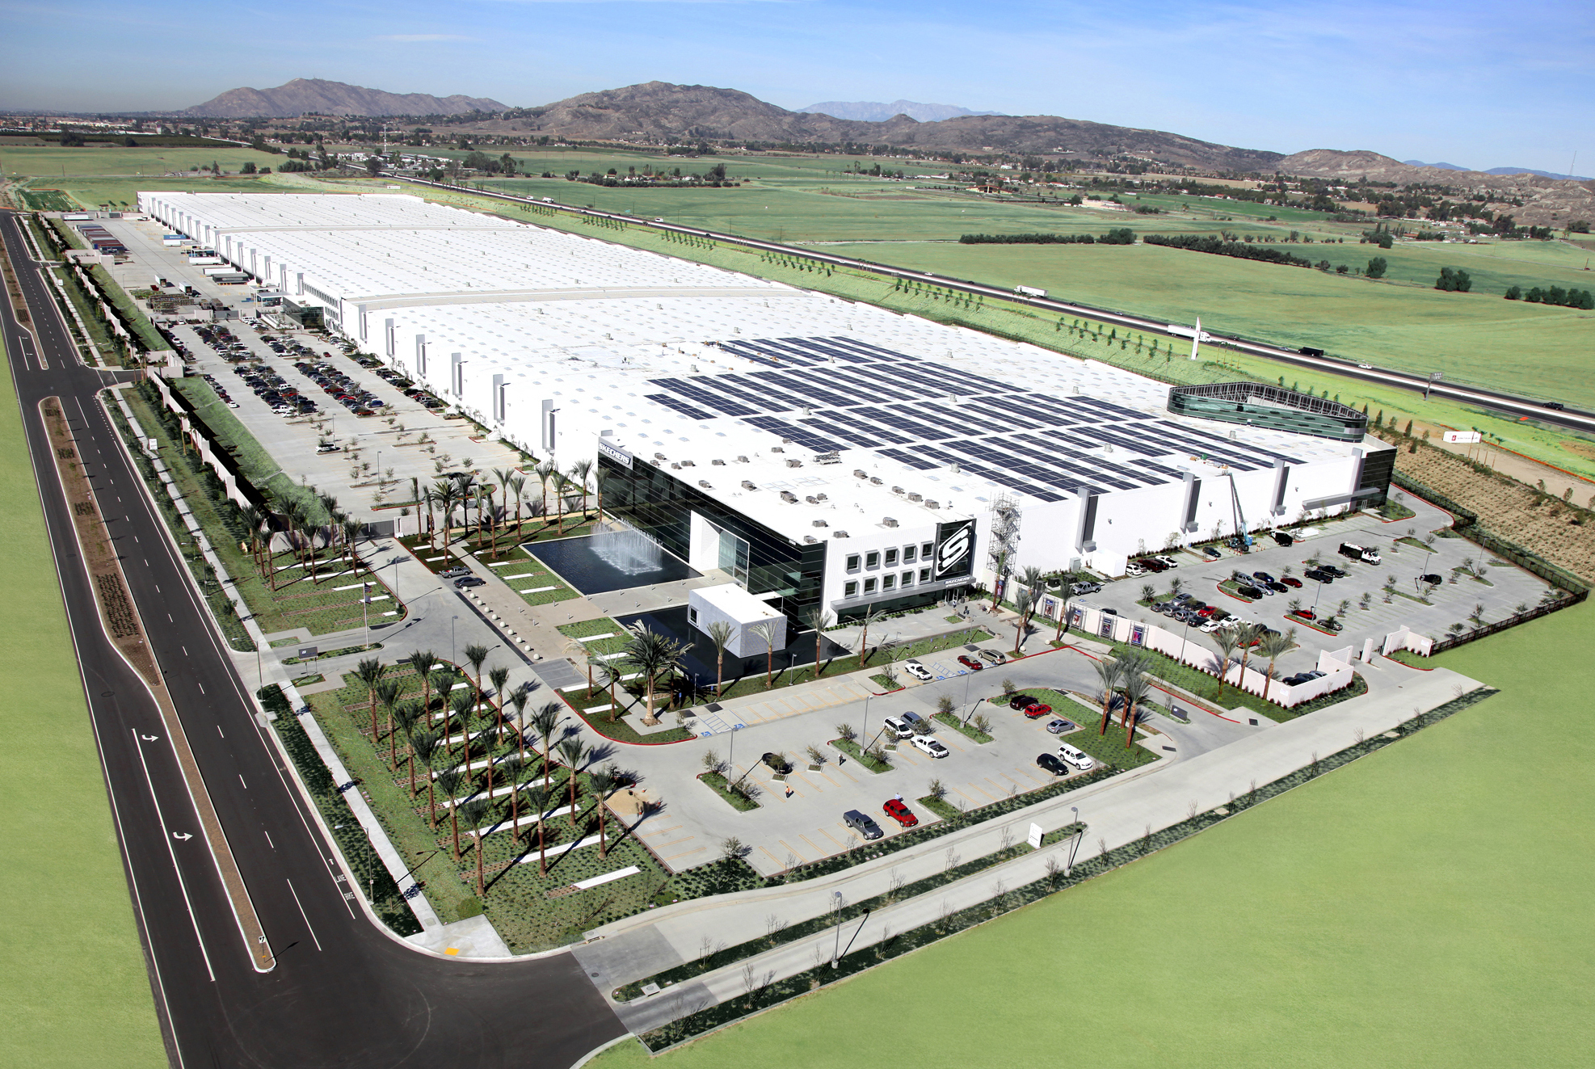
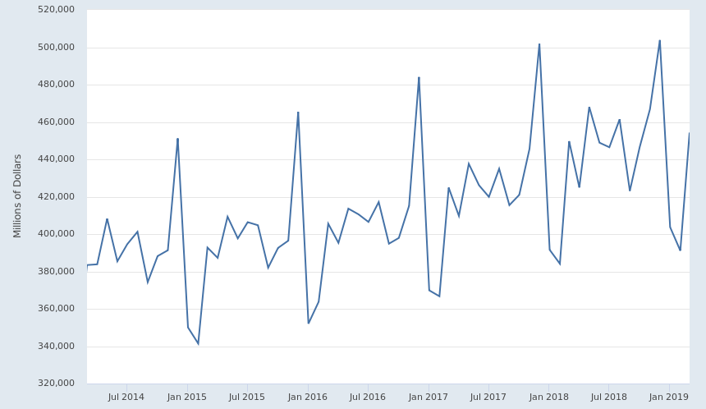
U.S. Retail Sales
(Excluding Food Services)
Notes:
These same principles apply to supply chain decisions; Underutilized capacity exists all over the supply chain. Just as one example, take distribution resources, which are static fixed assets. But demand and inventory requirements are not. We need new capabilities to create agility.
Extra.
, but we need advances in data science and analytics to operationalize decisions that were one tactical or strategic.

Slide 15

$∴$We need to think differently about how resources are acquired, managed and allocated to fulfill today’s customer requests.
3
Notes:
This brings me to my second key takeaway, which is that we need to rethink distribution and logistics design.
To close the gap between current operations and customer expectations, we need to think differently. This is the focus of my research.
Extra:
my research does this by harnessing data and combines this data with new models to drive agile and dynamic decision making.

Slide 16

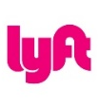







On-Demand Platforms
Requests:
Demand for a resource
Platform
(Central Mechanism):
Facilitates matches
Owns no resources
Systematic perspective
Agents:
Individual entities own the resources
Decentralized resources
Notes:
Interested in tapping into underutilized capacity. [make this claim]. This is different than some platforms – which create new capacity (Uber, example).
Let me give you an example.

Slide 17

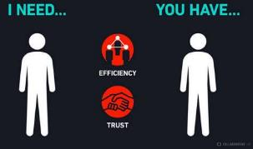
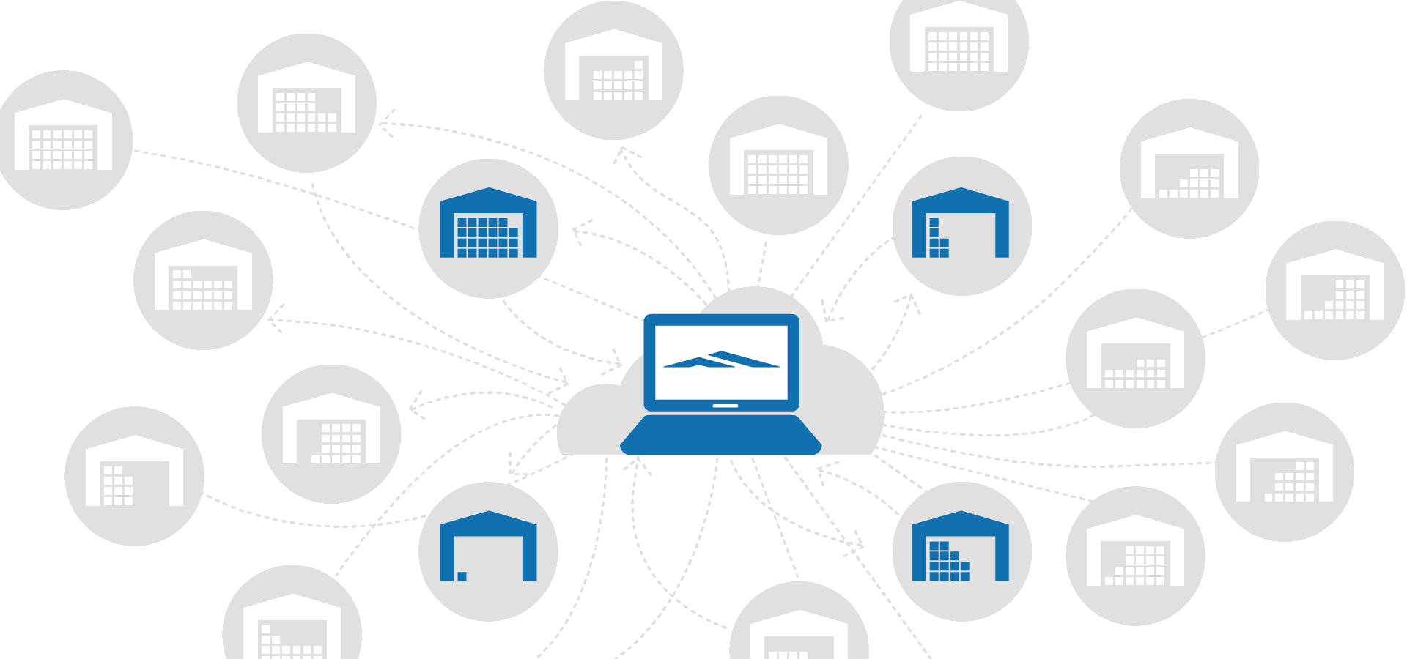
The On-Demand Economy
    On-Demand Systems:
    Business model that matches resources to requests on demand.
    On-Demand Peer-to-Peer (P2P) Systems:
    When the demand requests are fulfilled by peers, the resources are owned by independent users.
    On-Demand P2P Logistics Systems:
    A business model for the movement and storage of goods that matches independent supply resources (warehouse space, fulfillment services, truck space, delivery services) to requests for these resources, on demand.
Notes:
Marketplaces, in which a crowd of independent entities rent access to their resources, facilitate on-demand requests for warehouse space, fulfillment services, truck space, delivery services.

Slide 18

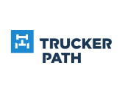
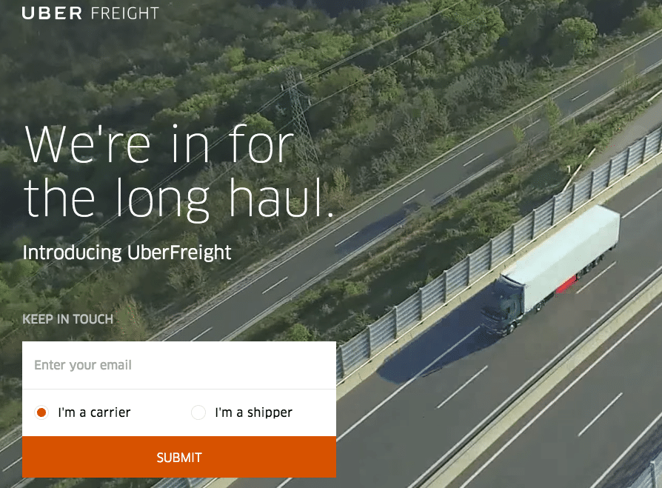



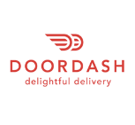
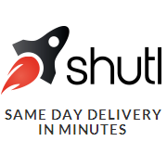




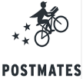






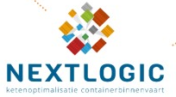













On-Demand P2P Logistics Systems
Movement of Goods: “Crowdshipping”
Long-Haul (City-to-City)
Delivery
Short-Haul
Delivery (B2B)
Last Mile Delivery (from * to customer)
Shipping Containers
(Country-to-Country)
Individual Courier Services
(from customer to *)
Storage of Goods
Emergency
Response
Notes:
Basically talk about slides 15 and 16 off of here.
ALAN: Coordination of resources donated from the private sector.
Marketplace that matches logistics business capabilities with the expressed needs of communities and relief agencies in response to a disaster.
US focused – others
Some players are also present in Europe. DHL (Germany) recently launched its own platform called DHL Spaces, created to bring together supply and demand of warehouse space: it gives the customer updated information about warehouse location, capacity available and contact [4]. On Stowga (UK), customers have access to information about the supplier’s location, facilities, services and price, but cannot see their contact information until a connection on the platform is established [8]. Stockspots (Netherlands) allows the customer to contact a chosen supplier and negotiate price and service conditions [9]. Waredock (Scandinavian countries) operates on a monthly bases and without minimum capacity limits [10].

Slide 19


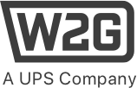






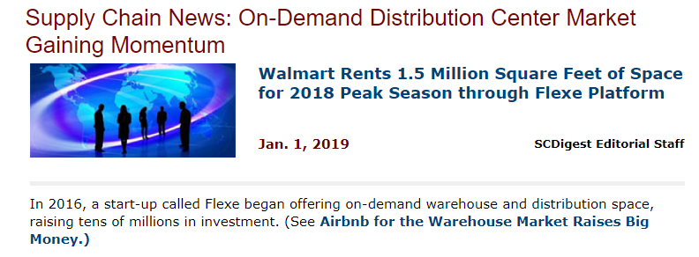

On-Demand Warehousing Platforms
On-demand warehousing platforms operate marketplaces (online platforms) to match companies with underutilized warehouse and distribution center (DC) capacities with customers who need extra space or fulfillment services.
Warehouse & Fulfillment
Supply Owners
Demand Requests /
Customers
Online Platform / Central Mechanism
1000+ warehouses on their platform
Notes:
2013 that now has more than 1000 warehouses on the platform
Rather than optimize planned resource capacity acquired through ownership or long-term partnerships, this work focuses on a specific innovation, on-demand distribution platforms. Such systems create spatial and temporal resource elasticity by accessing underutilized resources on-demand, where and when needed.
(On-demand distribution systems >> warehouse space, fulfillment capacity, truck space, delivery services)

Slide 20
Optimization Models to Evaluate On-Demand Warehousing Strategies
What are the borrowers’ benefits of
on-demand warehousing?
Given benefits, but also differences in cost structures, is there a business case for a company to use on-demand warehousing?
How should a company’s distribution network be designed given the genesis of on-demand options (as well as existing build and lease options)?
What influences these decisions?
Kaan Unnu,
Ph.D. student lead

Slide 21
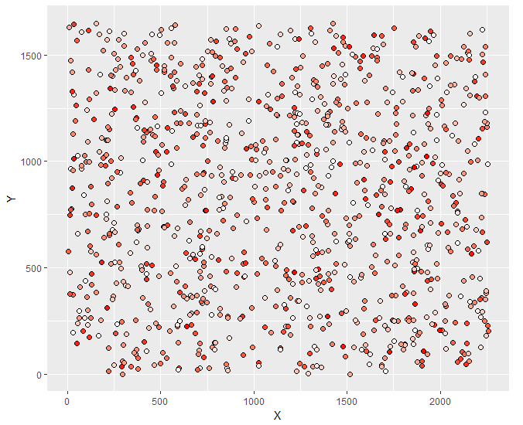
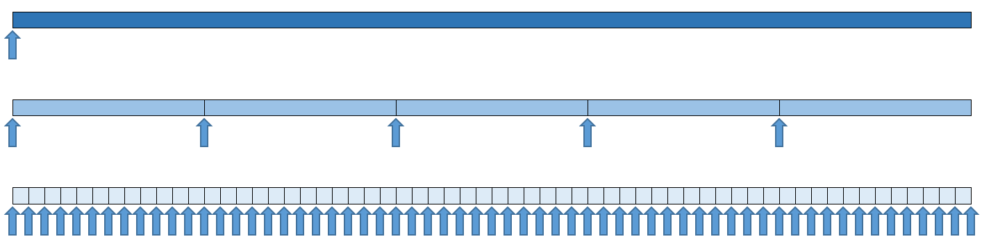
Benefits for Users of On-Demand Warehousing Solutions
Quick Access to Scale
Reduced Commitment Granularity
Reduced Capacity Granularity
Notes:
This new business model is open, available on-demand, on a per-use basis, and adaptable to demand variabilities.

Slide 22
How many DC’s does your organization operate in North America?
Simple math:
Number of Facilities
Response Time
more product closer to end consumers = faster + cheaper delivery
Notes:
Simple math: more product closer to end consumers = faster + cheaper delivery.

Slide 23
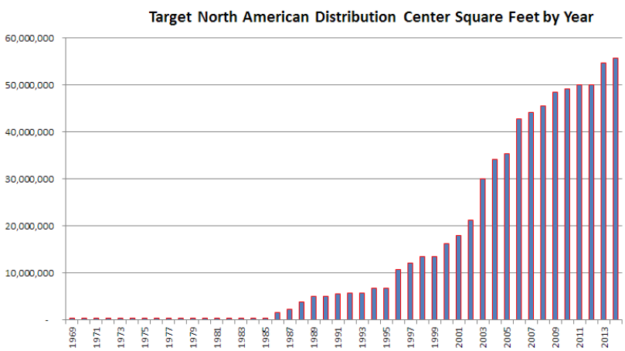

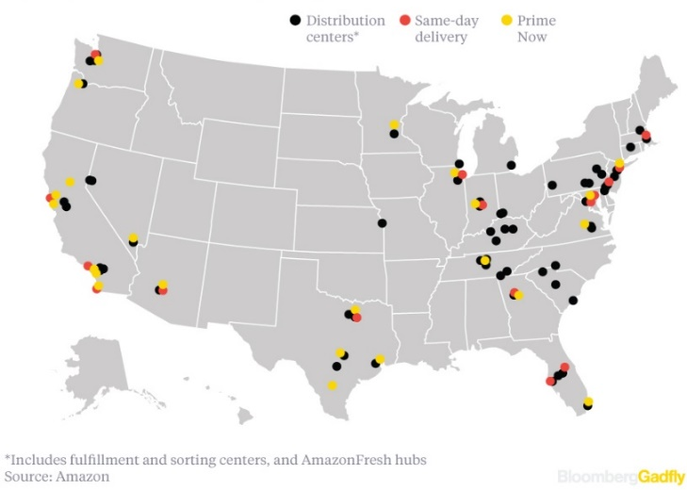

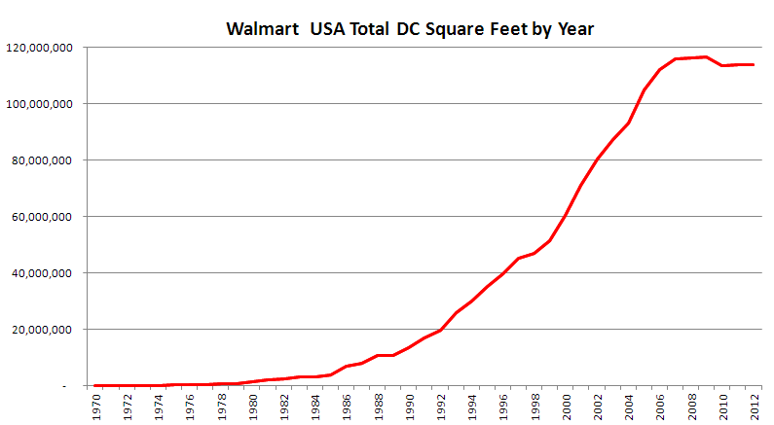
This Simple Math is why DC Capacities are Growing
DC SQ FT
http://www.mwpvl.com/html/target.html
Fulfillment Centers – 151
Prime Now Hubs – 52
...
Total – 389
http://www.mwpvl.com/html/walmart.html
Notes:
The shorter delivery requirements have raised investments in distribution centers and warehouses closer to large population areas, where the capital requirements are very high.
Not only costs, but also availability of warehouse space and distribution capability is a challenge today.

Slide 24
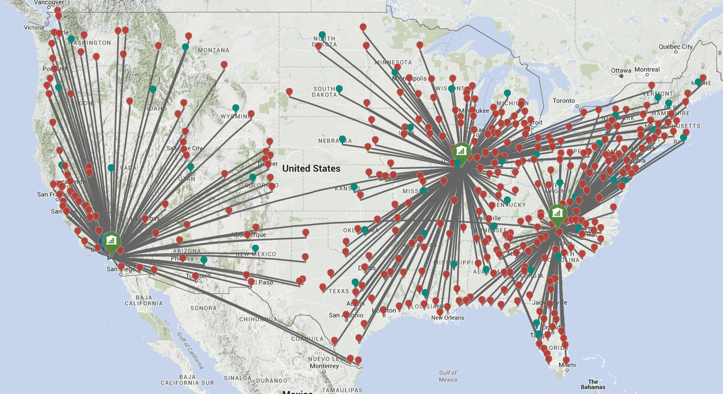
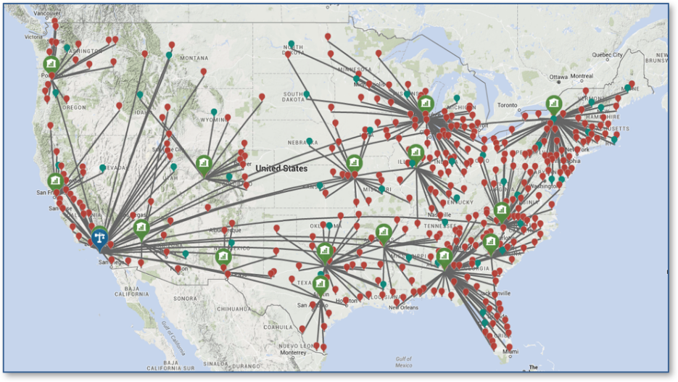
1. Quick Access to Scale
3 warehouses → 80%+ in 2 days
Access to Scale
16 warehouses → 90%+ in 1 day

Slide 25
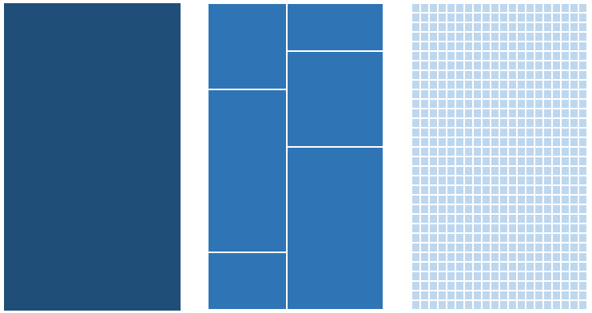
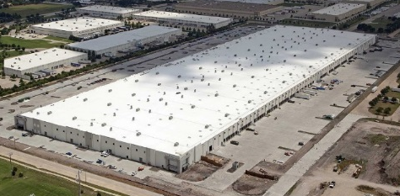
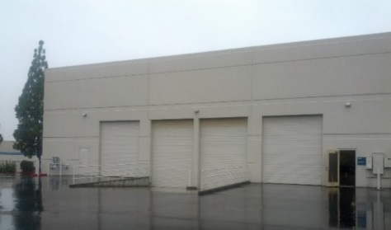
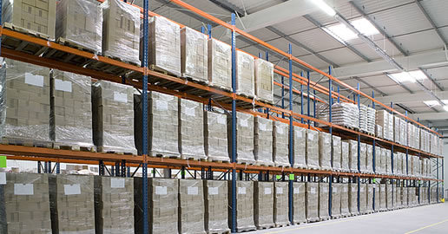
2 & 3. Reduced Capacity & Commitment Granularity
Capacity granularity: the minimum capacity that can be acquired by the options.
Build
Lease (3PL)
On-Demand
Platform
Flexibility, Agility, Responsiveness
Notes:
The other benefits are reduced capacity and commitment granularity. If a company decides to build a facility, this is a strategic decision, in which you have large fixed costs and that come with a long commitment. Leasing options can come with long decision lead times. Whereas in on-demand platform systems, distribution resources can be acquired at the pallet level and for only one month commitment periods. This leads to improved flexibility and agility, but also can make for more complex operations and systems.
Agility, Responsiveness,
Flexibility, Agility, Responsiveness
Fixed, long-term leases or building a facility are mismatch for dynamic inventory & high or uncertain growth

Slide 26
Benefits for Users of On-Demand Warehousing Solutions
Combined Together
Quick Access to Scale
Reduced Commitment Granularity
Reduced Capacity Granularity
On-Demand Warehousing can create a flexible and elastic distribution network
Notes:
This new business model is open, available on-demand, on a per-use basis, and adaptable to demand variabilities.

Slide 27
These benefits need to be traded off with different cost structures.
 | Type | Capacities (pallet) | Total DC cost of one pallet
 |  |  | Full Capacity Utilization | %85 Capacity Utilization
1 | Construct | 30,000 | $16.70 | $18.94
2 | Construct | 70,000 | $15.95 | $18.11
3 | Construct | 160,000 | $14.91 | $17.15
4 | Lease | 5,000 | $22.08 | $23.61
5 | Lease | 10,000 | $21.82 | $23.19
6 | Lease | 20,000 | $21.19 | $22.67
7 | Lease | 30,000 | $21.06 | $22.41
8 | Lease | 70,000 | $19.01 | $21.27
9 | Lease | 160,000 | $17.01 | $19.09
10 | On-demand | -- | $24.00 | $24.00
Annual inventory turns assumed as 12 turns.
K. Unnu, J.A. Pazour, “Analyzing Varying Cost Structures of Alternative Warehouse Strategies”, (2019). in Proceedings of the 2019 IISE Annual Conference, Orlando, FL
On-Demand is higher per unit, but only variable costs, no fixed costs.
Notes:
The cost calculation excel file is attached.
We consider following cost items during our calculations and also
the inventory turns have a significant impact on per pallet calculations.
Self-distribution:
Initial Costs: Land cost, building cost, salvage price, net present value, equipment (racks, trucks, WMS), upfront costs (agent, broker etc),
Operational Costs: monthly recurring costs (labor, management, overhead),
3PL/Lease:
Initial costs: Contract, account setup
Operational Costs: An average price per pallet used to calculate fixed monthly payments
Handling costs: Variable cost per pallet
On-demand:
Holding: per pallet per month
Handling: per pallet

Slide 28
Optimization Models to Evaluate On-Demand Warehousing Strategies
What are the borrowers’ benefits of
on-demand warehousing?
Given benefits, but also differences in cost structures, is there a business case for a company to use on-demand warehousing?
How should a company’s distribution network be designed given the genesis of on-demand options (as well as existing build and lease options)?
What influences these decisions?
Kaan Unnu,
Ph.D. student lead

Slide 29
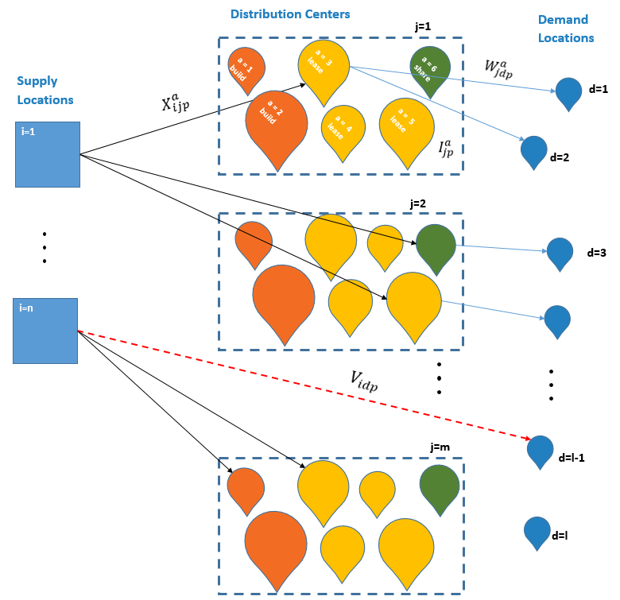
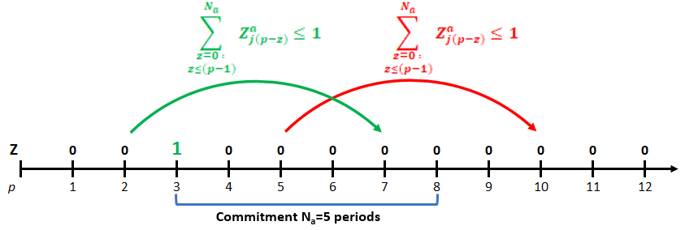
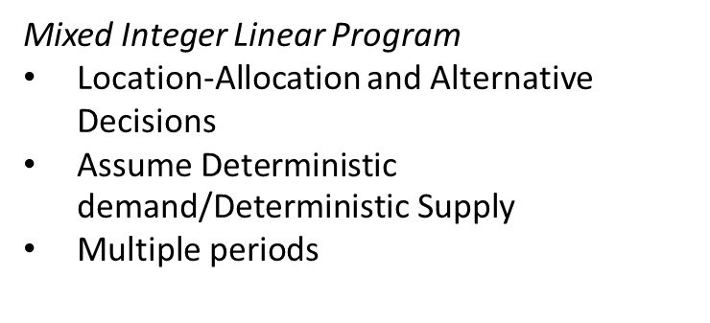
Non-Simple Math
a multi-period capacitated facility location-allocation model with different commitments and capacity granularity options considering different warehouse alternatives simultaneously.
Mixed Integer Linear Program
Location-Allocation and Alternative Decisions
$\text{Assume} \text{Deterministic} \text{demand}\text{/}\text{Deterministic} \text{Supply}$
$\text{Multiple} \text{periods}$
 | Type | Capacities | Commitments
1 | Construct (small size) | 30,000 | 60 months
2 | Construct (med size) | 70,000 | 60 months
3 | Construct (large size) | 160,000 | 60 months
4 | Long-term lease (Cap1) | 5,000 | 12 months
5 | Long-term lease (Cap2) | 10,000 | 12 months
6 | Long-term lease (Cap3) | 20,000 | 12 months
7 | Long-term lease (Cap4) | 30,000 | 12 months
8 | Long-term lease (Cap5) | 70,000 | 12 months
9 | Long-term lease (Cap6) | 160,000 | 12 months
10 | On-demand | Uncapacitated | 1 month
Notes:
Simple math: more product closer to end consumers = faster + cheaper delivery.

Slide 30
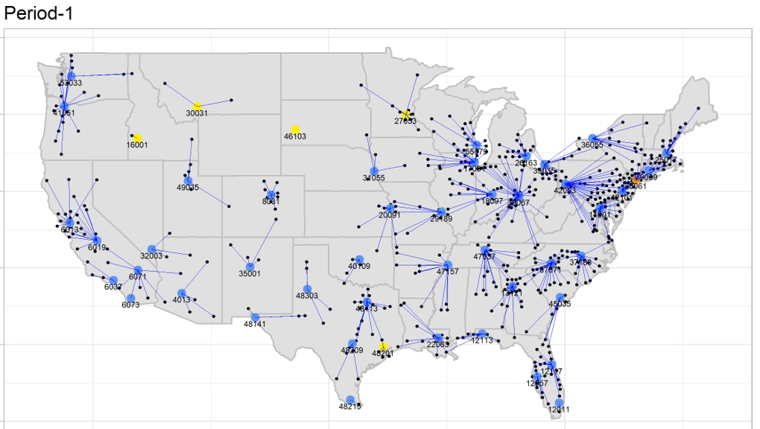
How should a company’s distribution network be designed given the genesis of on-demand options (w/ existing build and lease options)?
Notes:
Comment Time Periods and changing locations, types and allocations.

Slide 31
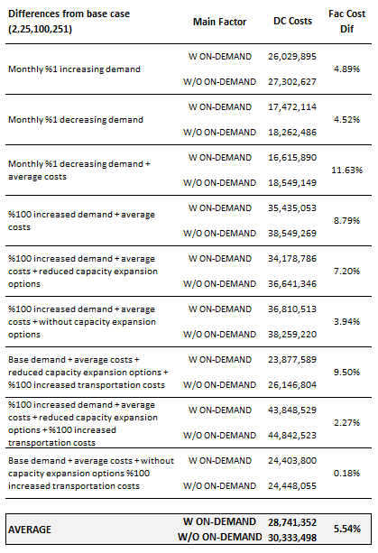
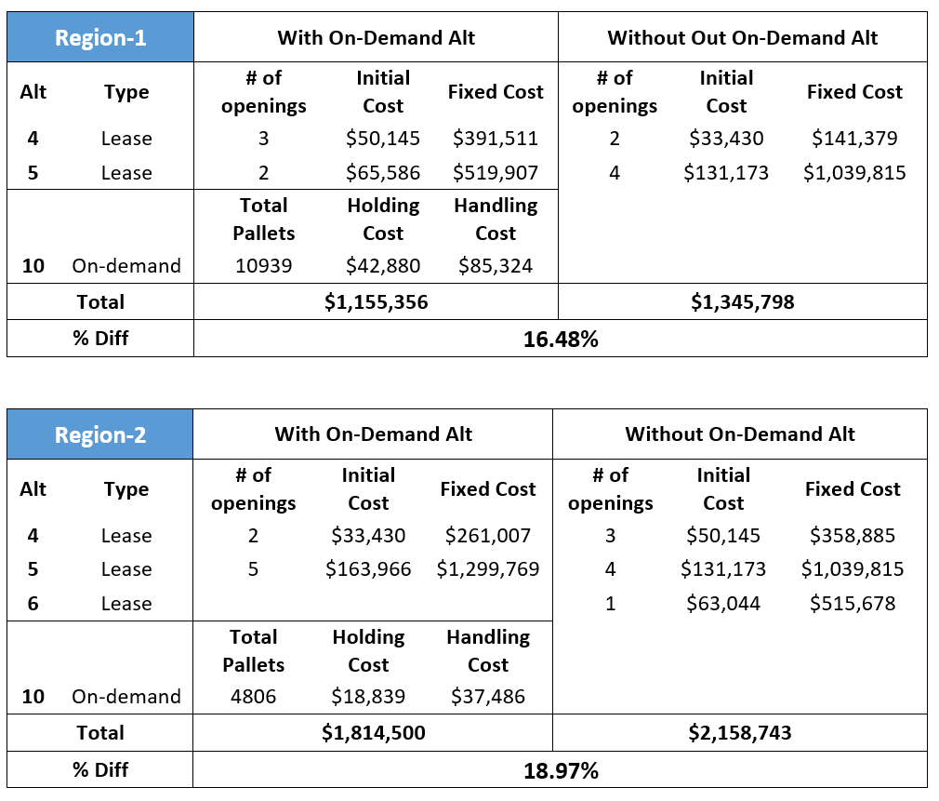
ANALYSIS OF EXAMPLES
Comparison of multiple scenarios with and without on-demand alternative
Average %5.54 reduction in Distribution Center Costs with on-demand alternative
More significant facility cost difference in some regions
Notes:
Finally, we compare the facility cost differences between with and without on-demand options in Table 18. When comparing solutions between the model with the on-demand option and the without, we also identified that the aggregate national solution did not change as much as these regional ones. There exists a comparing to the overall national solution. In some other regions the on-demand option is never used or used for a small amount of the total demand.
Additionally, when we compare the total distribution costs (~objective function value), the total improvement for region-2 could only be calculated as 1,5%, because of the ~20M$ transportation costs.

Slide 32
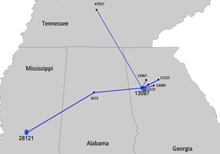
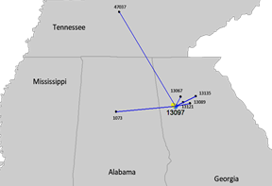
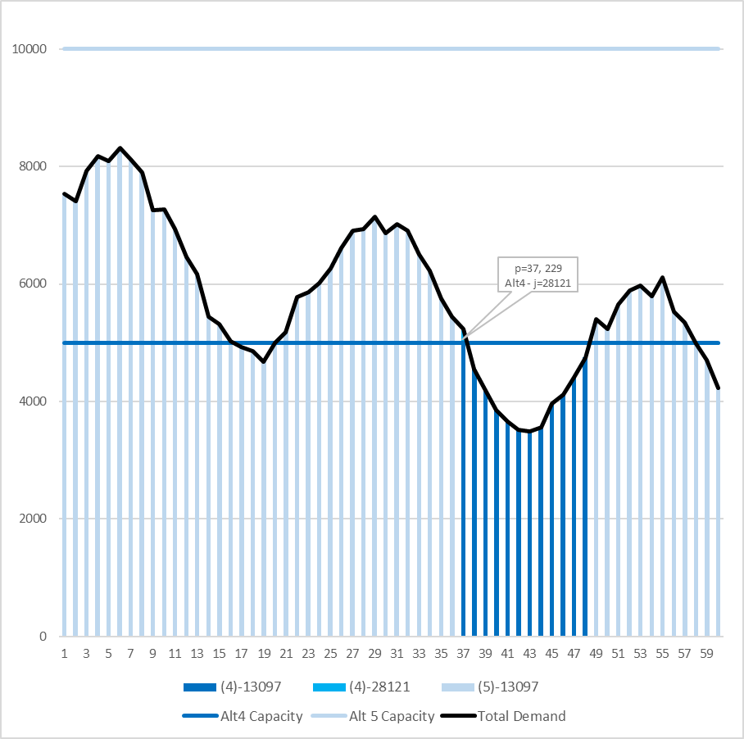
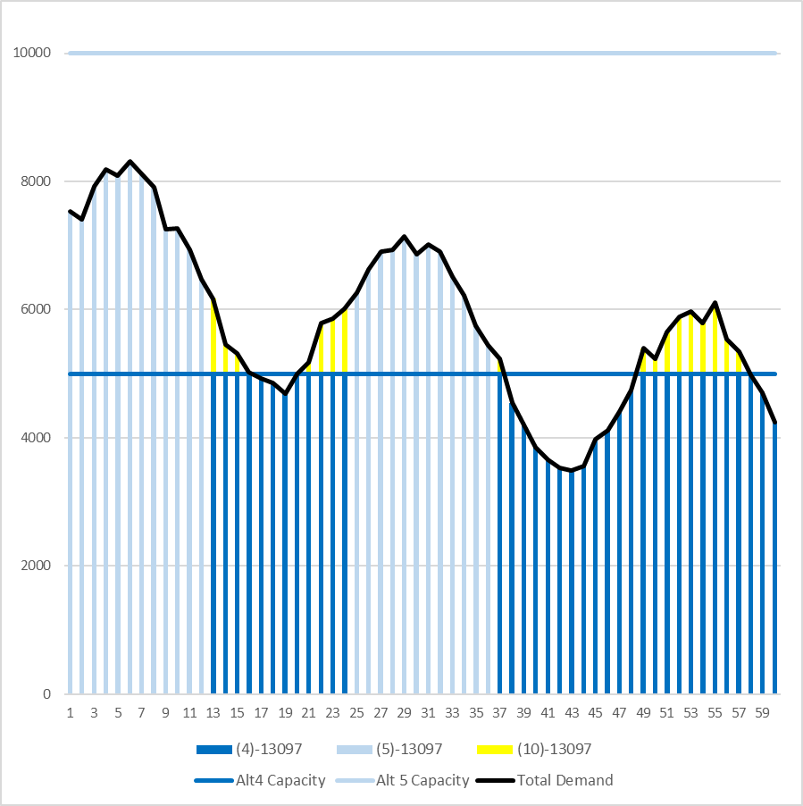
ANALYSIS OF EXAMPLES
Capacity Alt 5
Without On-Demand
On-Demand
On-Demand
Capacity Alt 4
Alt
5
Alt
4
Alt
5
Alt
5
Alt
4
Alt
5
Alt
4

Slide 33
What influences these decisions? DESIGN OF EXPERIMENTS
On-demand Alternative
With on-demand alternative
Without on-demand alternative
Demand Trend*
Increasing Demand (trend up wards)
Seasonality*
No seasonal effect
Demand Variability*
Low variability
Customer dispersion
~100 demand locations
Response requirement
100 miles range (same day delivery)
No trends in demand
Decreasing Demand (trend down wards)
Major Seasonal effects
Major variability
~1000 demand locations
250 miles range (next day delivery)
1000 miles range
2
3
2
Capacity + Commitment
Capacity + Commitment
2
2
3
Capacity + Commitment
Access to scale
Access to scale
* Assumption: Total demand is equal in all scenarios

Slide 34
On-Demand models provide quick access to scale through lower capacity and commitment granularities, but with different cost structures than traditional options.
4
Notes:
This brings me to my second key takeaway, which is that we need to rethink distribution and logistics design.
To close the gap between current operations and customer expectations, we need to think differently. This is the focus of my research.
Extra:
my research does this by harnessing data and combines this data with new models to drive agile and dynamic decision making.

Slide 35
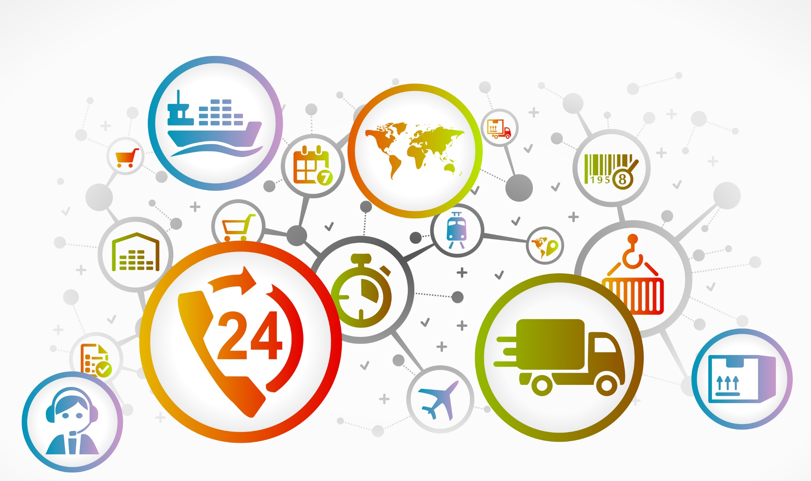


Distribution Networks of the Future will be Radically Different
Needed are systems & processes that enable us to move from a fixed network to a dynamic, agile, resource network.

Slide 36
Resources:
Dynamic
Modular
Elastic
Scalable
Connected
Supply-Side Innovation Abounds
Systems:
Collaborative
On-Demand
Open
Connected
Data-Driven
5
Notes:
Our research is interested in this question, and we believe the answer is yes, but it requires companies to think differently and embrace supply-side innovation different than what’s worked in the past. Supply and capacity resources must not be static, but instead need to be dynamic, modular, elastic, and scalable. How do you do this? Well you embrace systems that are collaborative, open, and accessed on-demand.
This brings me to my third key takeaway, which is that by embracing supply-side innovation, companies can compete in today’s marketplace.

Slide 37

Agility
Notes:
These are all examples which provide a company with Agility – which refers to a supply chain’s ability to be flexible and quickly respond to changing needs. An agile supply chain is a data-driven supply chain, that uses real-time data and updated information to make and update operational decisions.

Slide 38

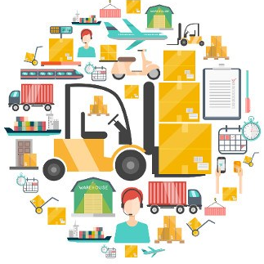
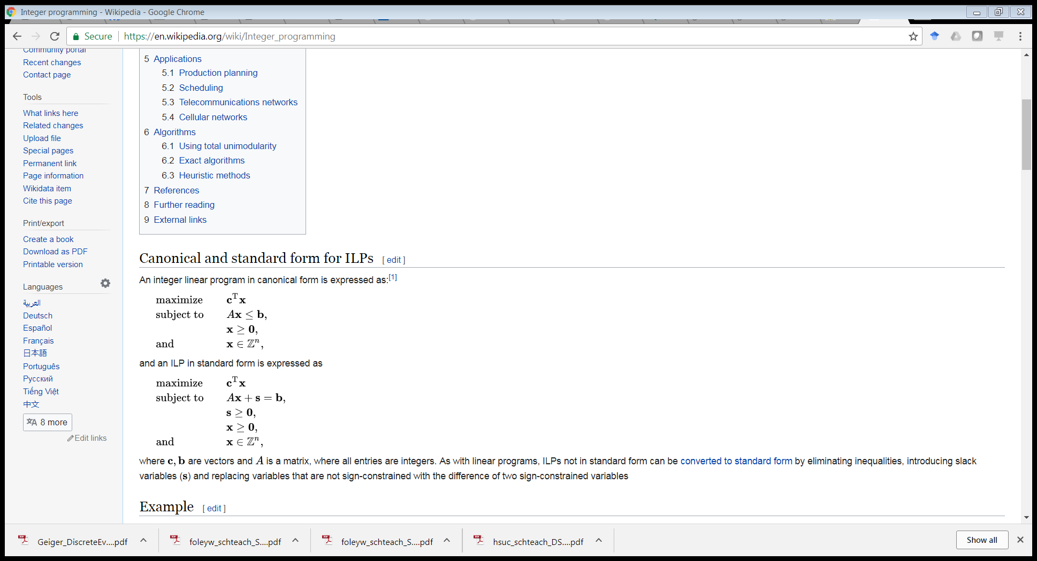

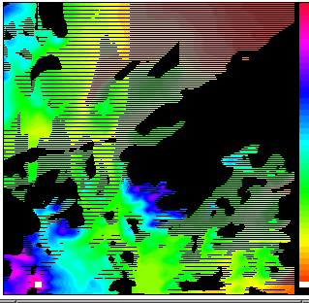
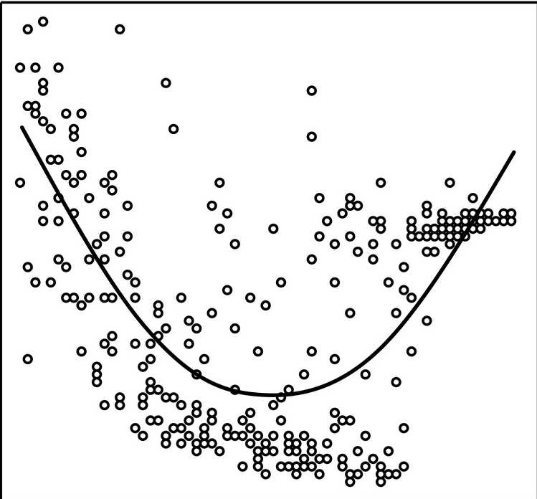
Harness Data & Create Models/Algorithms to Drive Agile Decisions
Distributed
Data
Mathematical & Computational Models
Massive
Conflicting Objectives
Limited Resources
Combinatorial Many Options
Trade-Offs
Sparse
Uncertain
Notes:
Harnessing data and creating models to drive agile decision making is exciting, but also challenging.
Why? Well, first the data is messy. More formally, it’s distributed, coming from many external sources, with mixed provenance, and heterogeneous fields and meanings. It is also being collected at different scales and units. For example, some of the data could come from sensors on a customer, other data is based on aggregate population statistics, while other data is found in unstructured notes on social media.
The date is also massive, meaning there’s more data than a human can effectively process.
But at the same time, it’s sparse, meaning while we often times have tons of data, we don’t have all the data we want; thus, we need to learn and predict and estimate.
Also, it’s uncertain, the data doesn’t tell us everything; we don’t have perfect models to infer cause and effect.
And, in my opinion, data is only half the story.
For supply chain challenges, as well as many complex engineering and societal systems, data is not enough. We need to combine the data with new models able to capture context in the form of causal relationships and to enforce constraints. Combined together, we can start to prioritize decisions when there’s conflicting objectives, limited resources, and combinatorically many options. Once we understand the trade-offs, then I believe we can start making decisions.

Slide 39
Key Takeaways
Distribution & Logistics are at an Inflection Point.
We need to Rethink Distribution and Logistics Design.
We need to think differently about how resources are acquired, managed and allocated to fulfill today’s customer requests.
On-Demand models provide quick access to scale through lower capacity and commitment granularities, but with different cost structures than traditional options.
Other Supply-Side Innovations Abound
Notes:
To Recap, First, it’s an extremely disruptive time to be in supply chains. We are at an inflection point; old thinking is out, new thinking is needed. Second, we need to rethinking distribution and logistics design to move supply chains from fixed, monolithic resources, to dynamic and agile ones. And third, innovation abounds on both the supply and demand side of the equation.

Slide 40
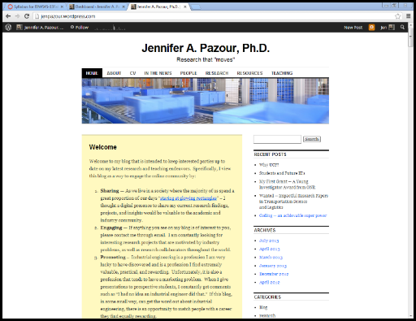


Questions, Comments, Concerns?
Jennifer Pazour, Ph.D.,
Associate Professor of Industrial
and Systems Engineering
Rensselaer Polytechnic Institute (RPI)
Troy, New York, USA
http://jenpazour.wordpress.com/
Email:
pazouj@rpi.edu
Twitter: jpazour
Jennifer Pazour

